Slide 1
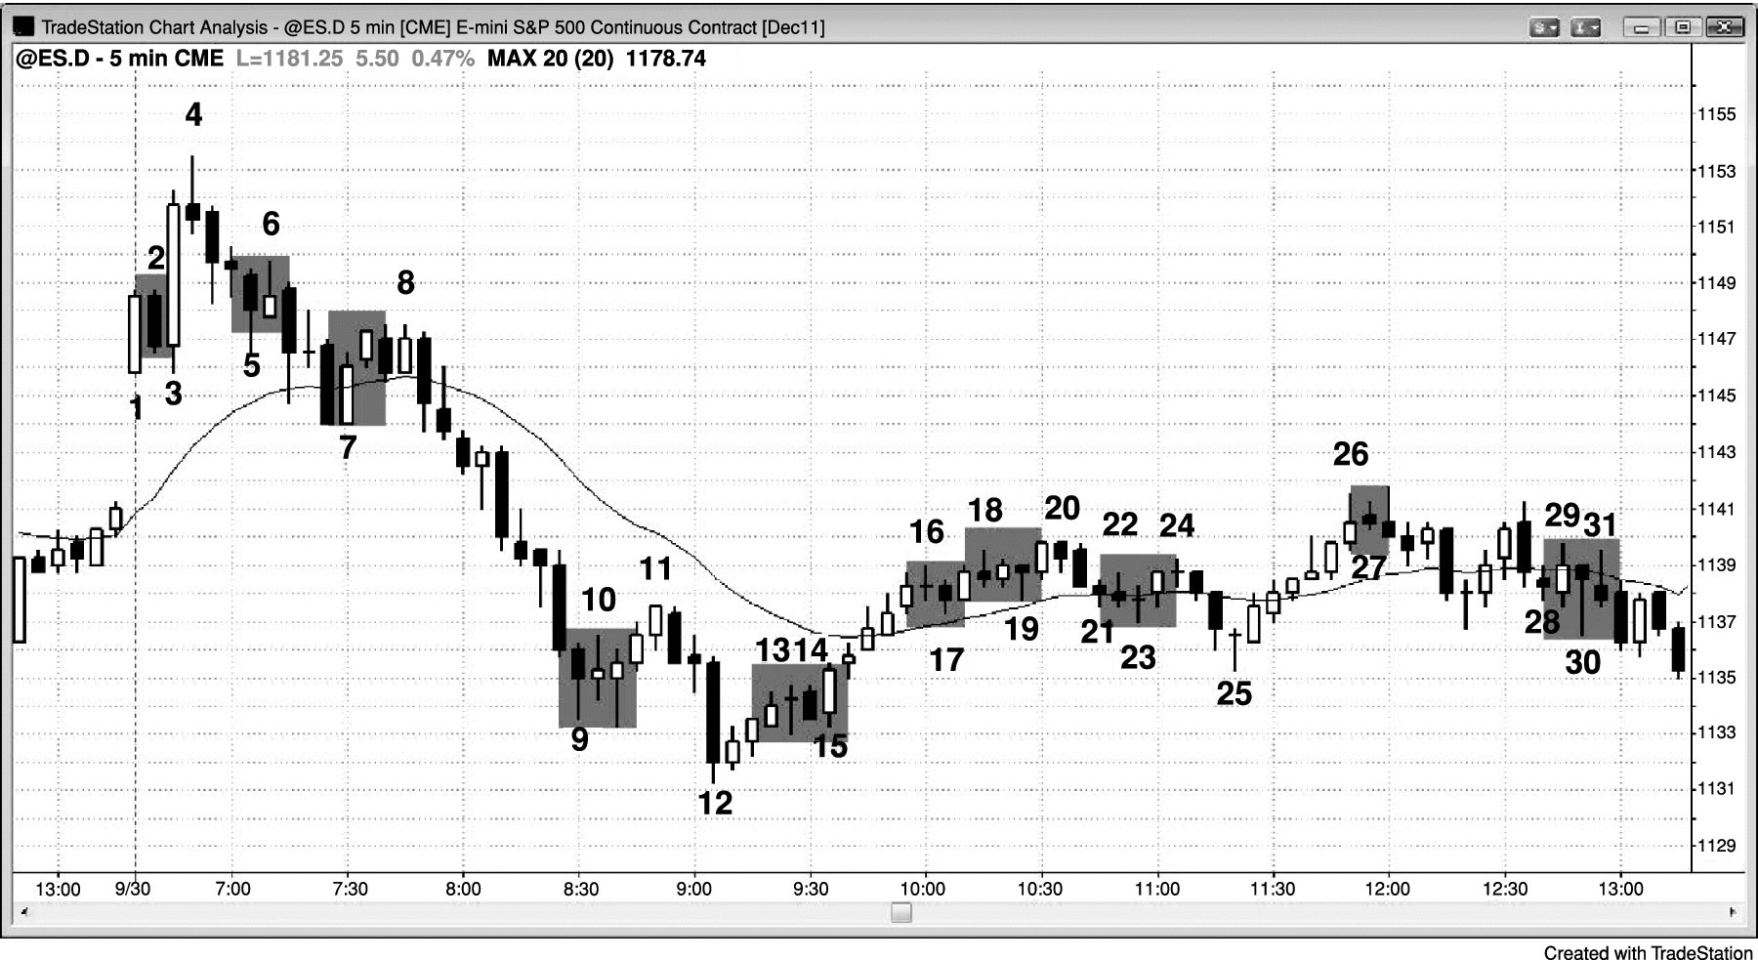
FIGURE 32.1 Trapped Traders

